Slide 1
Topic Modelling - Team 2 (P57)
PremSai Sahoo
Ranjeet Kashid
Akash Kulkarni
Vadhadiya Srina
Ranjitha R

Slide 2
Definition
Working Mechanism
Topic modelling is a machine learning technique that automatically analyses text data to determine cluster words for a set of documents.
It is an unsupervised approach used for finding and observing the bunch of words (called “topics”) in large clusters of texts.
Topic modelling provides us with methods to organize, understand and summarize large collections of textual information.
Topic modelling involves counting words and grouping similar word patterns to infer topics within unstructured data.
By detecting patterns such as word frequency and distance between words, a topic model clusters feedback that is similar, and words and expressions that appear most often.
With this information, we can quickly deduce what each set of texts are talking about.

Slide 3
Methods in Topic Modelling
Following are few methods by which Topic Modelling can be performed:
Non Negative Matrix Factorization (NMF)
Latent Semantic Analysis (LSA)
Parallel Latent Dirichlet Allocation (PLDA)
Pachinko Allocation Model (PAM)
Latent Dirichlet Allocation (LDA)
All these methods aid us in getting the correct information from the extracted/provided data. It keeps us focused on the correct portion of data by removing unnecessary data from the corpus. These methods are highly useful in obtaining the business value from the data.
We can use above methods and can finalize on the method that provides the best results.

Slide 4
Business Objective
Project Process Flow
Social event tracking and evolution framework to obtain the evolutionary trends of social events and generate effective event summary details over time.
Business Problem
Data Collection
Data Cleaning and Preprocessing
EDA
Model Building
Deployment
Finalizing Model
Evaluation

Slide 5
Data Collection - Web Scraping
Web scraping, web harvesting, or web data extraction is data scraping used for extracting data from websites.
It is a form of copying in which specific data is gathered and copied from the web, typically into a central local database or spreadsheet, for later retrieval or analysis.
Classification types of web scraping tools:
Built - Self Built/ Pre Built
Form - Browser extension/ Software
Running support - Cloud/ Local
In our project we have scraped data from “Google News” by using query as “social event”.

Slide 6
Data Cleaning and Preprocessing
In data cleaning we performed following operations:
Converting to lowercase
Removing punctuations
Removing short words
Removing stopwords
Removing mentions,urls,emojis, numbers
Removing spaces and newlines
Lemmatization

Slide 7
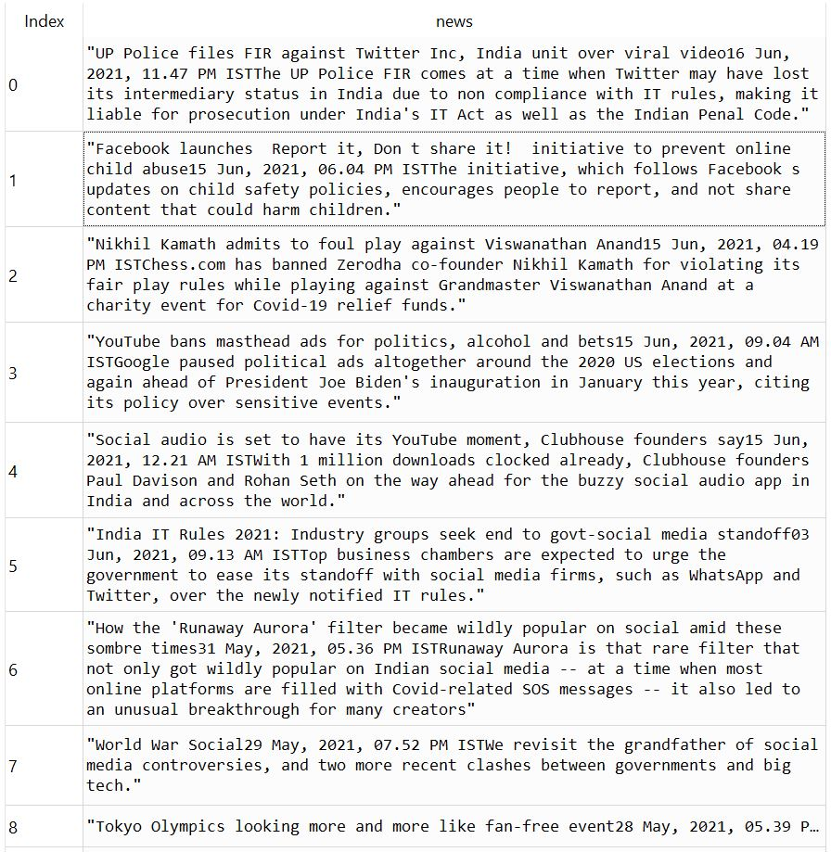
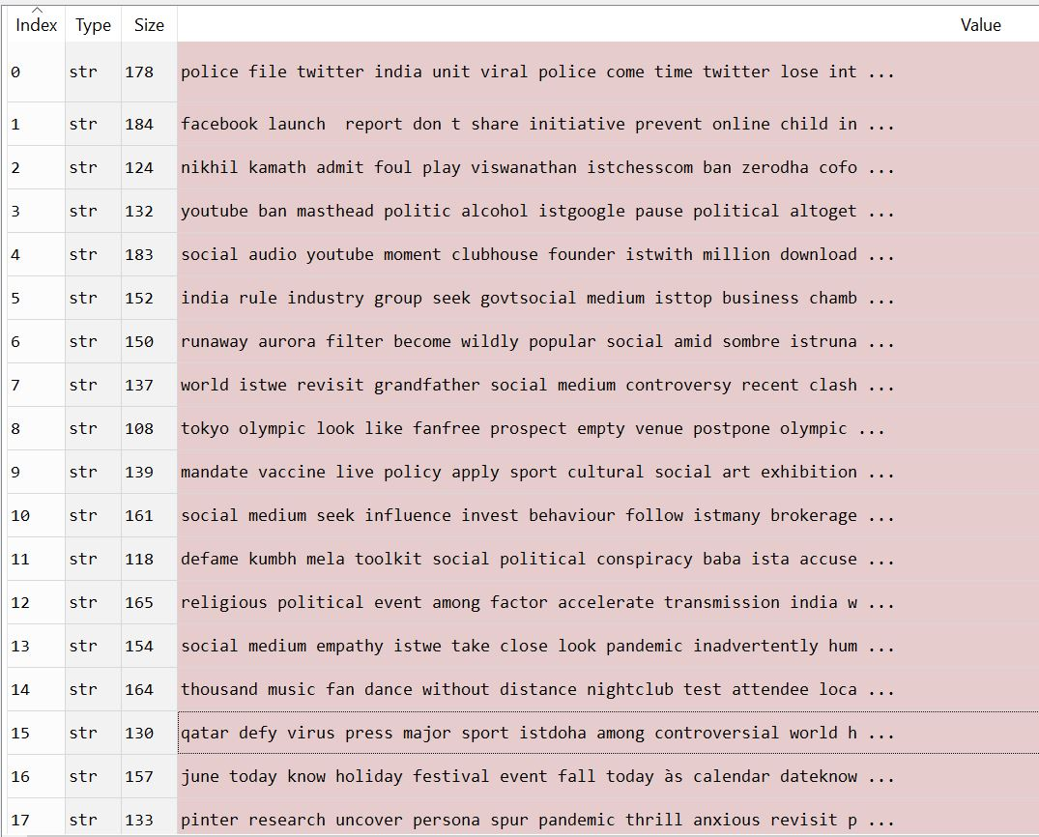
Data Cleaning and Preprocessing
BEFORE
AFTER

Slide 8
Exploratory Data Analysis - EDA
Exploratory data analysis (EDA) is used by data scientists to analyze and investigate data sets and summarize their main characteristics, often employing data visualization methods.
It helps determine how best to manipulate data sources to get the answers you need, making it easier for data scientists to discover patterns, spot anomalies, test a hypothesis, or check assumptions.
The main purpose of EDA is to help look at data before making any assumptions.
It can help identify obvious errors, as well as better understand patterns within the data, detect outliers or anomalous events, find interesting relations among the variables.

Slide 9
Four Types of EDA
Common graphs
Steps involved in EDA
Univariate non-graphical
Multivariate non-graphical
Univariate graphical
Multivariate graphical
Bar plot
Histogram
Box chart
Scatter plot
Data Cleaning
Imputation Technique
Data Analysis and Visualization
Transformations
Notes:
For types of EDA read out the description from word document

Slide 10
EDA for Topic Modelling
We have conducted the following EDA for our project:
Feature Extraction
News Length
WordCloud
Unigram
Trigram

Slide 11
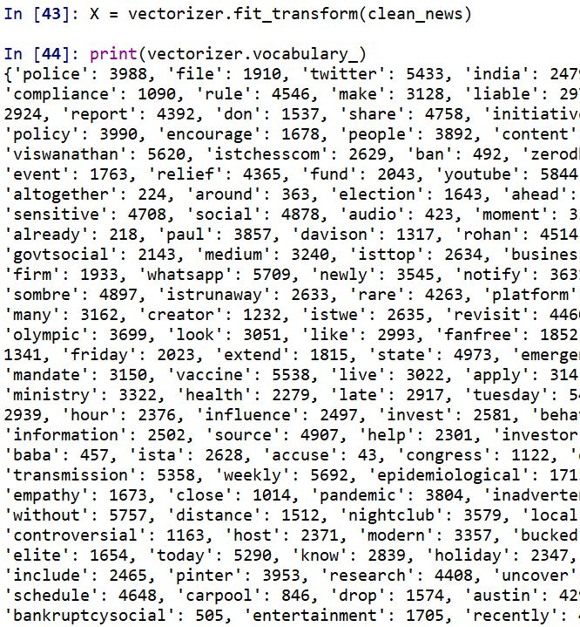
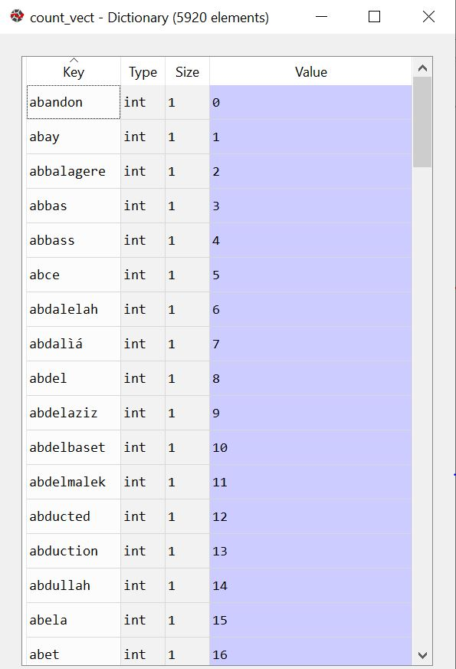
EDA - Feature Extraction
In feature extraction we made the CountVectorizer and understood the unique number of words, which were present in the document. In our data we achieved a word count of 5920 words.

Slide 12
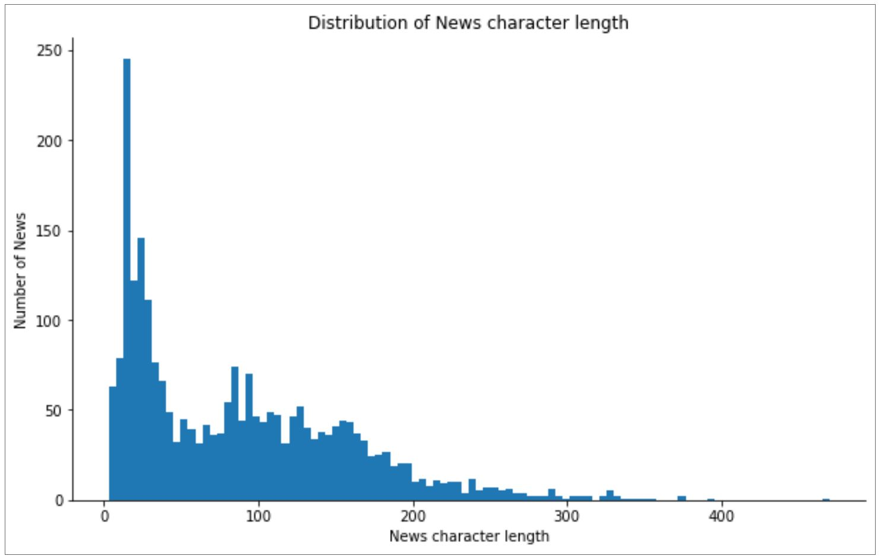
EDA - News Length
Plotted the number of words present in the documents, to get an understanding of how big the news were.

Slide 13
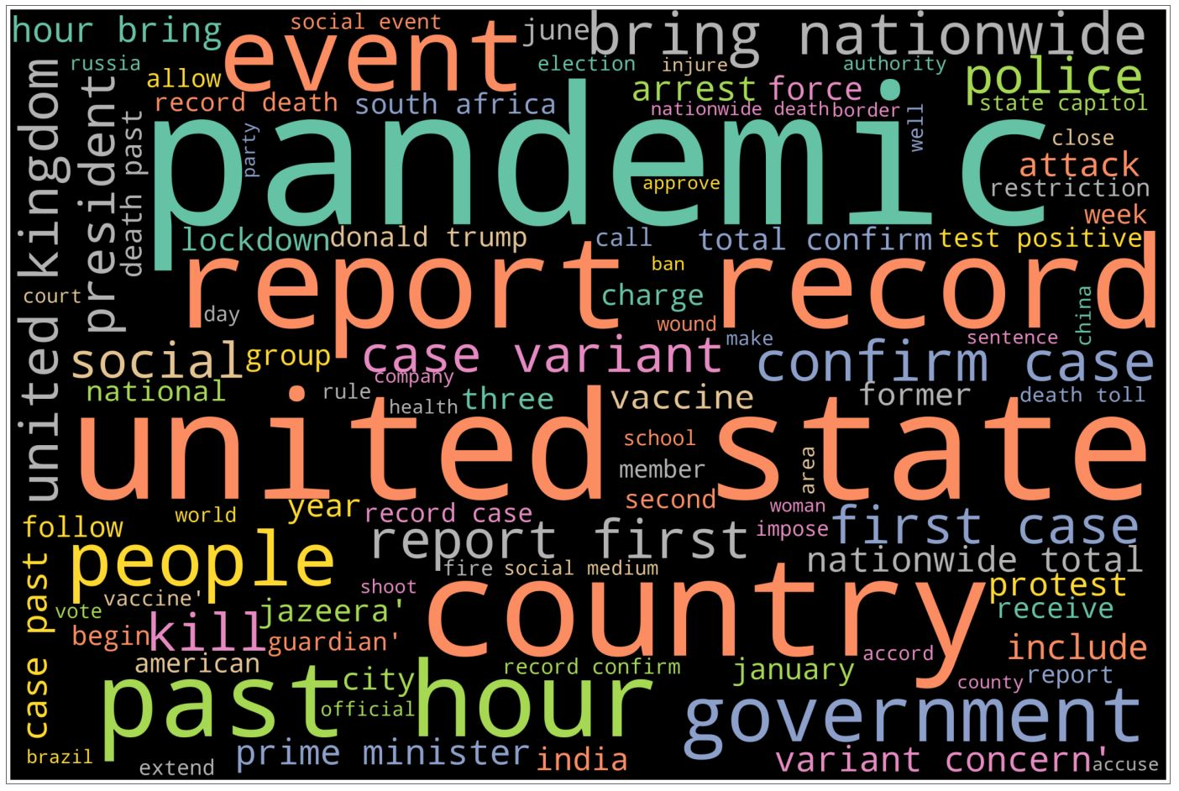
EDA - WordCloud
Plotted a wordcloud to understand the prominent words which were repeated more frequently.

Slide 14
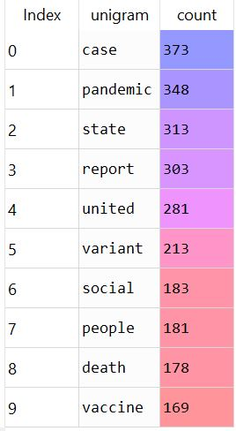
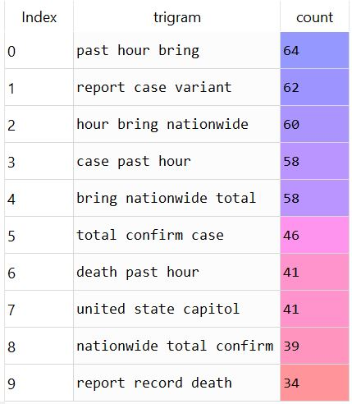
EDA - Unigram & Trigram
Calculated the unigram to find the most repeated single words.
Calculated the trigram to find the most repeated phrases(containing 3 words).

Slide 15
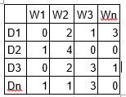
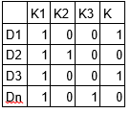
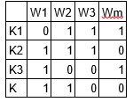
Model Building
We have used LDA method in Topic Modelling, LDA being the most popular method for Topic Modelling.
LDA assumes documents are produced from a mixture of topics. Those topics then generate words based on their probability distribution. Given a dataset of documents, LDA backtracks and tries to figure out what topics would create those documents in the first place.
LDA is a matrix factorization technique. In vector space, any corpus (collection of documents) can be represented as a document-term matrix. The following matrix shows a corpus of N documents D1, D2, D3 … Dn and vocabulary size of M words W1,W2 .. Wn. The value of i,j cell gives the frequency count of word Wj in Document Di.
LDA converts this Document-Term Matrix into two lower dimensional matrices – M1 and M2. M1 is a document-topics matrix and M2 is a topic – terms matrix with dimensions (N, K) and (K, M) respectively, where N is the number of documents, K is the number of topics and M is the vocabulary size.
M1
M2

Slide 16
Model Building - Contd.
Notice that these two matrices already provides topic word and document topic distributions. However, these distribution needs to be improved, which is the main aim of LDA. LDA makes use of sampling techniques in order to improve these matrices.
It iterates through each word “w” for each document “d” and tries to adjust the current topic – word assignment with a new assignment. A new topic “k” is assigned to word “w” with a probability P which is a product of two probabilities p1 and p2.
For every topic, two probabilities p1 and p2 are calculated. P1 – p(topic t / document d) = the proportion of words in document d that are currently assigned to topic t. P2 – p(word w / topic t) = the proportion of assignments to topic t over all documents that come from this word w.
The current topic – word assignment is updated with a new topic with the probability, product of p1 and p2. In this step, the model assumes that all the existing word – topic assignments except the current word are correct. This is essentially the probability that topic t generated word w, so it makes sense to adjust the current word’s topic with new probability.
After a number of iterations, a steady state is achieved where the document topic and topic term distributions are fairly good. This is the convergence point of LDA.

Slide 17
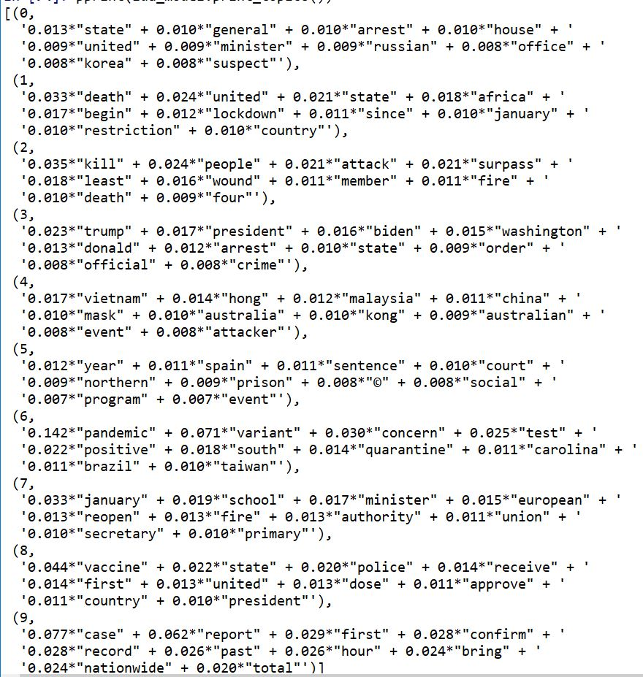
Model Building - LDA
Created a id2word dictionary, corpus and using following algorithm created the LDA Model:
lda_model=gensim.models.LdaMulticore(
corpus=corpus,
id2word=id2word,
num_topics=10,
random_state=100,
chunksize=100,
passes=10,
per_word_topics=True)
Received the following topics as output:

Slide 18
Model Evaluation
Topic model evaluation is the process of assessing how well a topic model does what it is designed for.
Evaluating a topic model can help you decide if the model has captured the internal structure of a corpus (a collection of text documents).
More generally, topic model evaluation can help you answer questions like:
Are the identified topics understandable?
Are the topics coherent?
Does the topic model serve the purpose it is being used for?

Slide 19
Model Evaluation - Contd.
There are a number of ways to evaluate topic models, including:
Human judgment
Observation-based, eg. observing the top ‘N’ words in a topic
Interpretation-based, eg. ‘word intrusion’ and ‘topic intrusion’ to identify the words or topics that “don’t belong” in a topic or document
Quantitative metrics – Perplexity (held out likelihood) and coherence calculations
Mixed approaches – Combinations of judgment-based and quantitative approaches
While evaluation methods based on human judgment can produce good results, they are costly and time-consuming to do.
Moreover, human judgment isn’t clearly defined and humans don’t always agree on what makes a good topic.
In contrast, the appeal of quantitative metrics is the ability to standardize, automate and scale the evaluation of topic models.

Slide 20
Model Evaluation - Contd.
Quantitative Metrics:
Perplexity:
Perplexity is a measure of how successfully a trained topic model predicts new data.
In LDA topic modeling of text documents, perplexity is a decreasing function of the likelihood of new documents. In other words, as the likelihood of the words appearing in new documents increases, as assessed by the trained LDA model, the perplexity decreases. And vice-versa.
The idea is that a low perplexity score implies a good topic model, ie. One that is good at predicting the words that appear in new documents.
Although this makes intuitive sense, studies have shown that perplexity does not correlate with the human understanding of topics generated by topic models.
Hence, while perplexity is a mathematically sound approach for evaluating topic models, it is not a good indicator of human-interpretable topics.

Slide 21
Model Evaluation - Contd.
Quantitative Metrics:
Coherence:
Coherence measures the degree of semantic similarity between the words in topics generated by a topic model.
The more similar the words within a topic are, the higher the coherence score, and hence the better the topic model.
There are a number of ways to calculate coherence based on different methods for grouping words for comparison, calculating probabilities of word co-occurrences and aggregating into a final coherence measure.
Coherence is a popular approach for quantitatively evaluating topic models and has good implementations in coding languages such as Python and Java.

Slide 22
Model Evaluation - Contd.
For the basic model created, we used the following codes and achieved the respective scores:
Perplexity:
print('\nPerplexity: ', lda_model.log_perplexity(corpus))
Perplexity score = -8.1642
Coherence:
coherence_model_lda = CoherenceModel(model=lda_model, texts=data_lemmatized, dictionary=id2word, coherence='c_v')
coherence_lda = coherence_model_lda.get_coherence()
print('\nCoherence Score: ', coherence_lda)
Coherence Score = 0.42463

Slide 23
Model Optimisation
By tuning the hyperparameters, we can optimise the model further. In this case, I have tuned the following hyperparameters:
Number of Topics (K)
Dirichlet hyperparameter alpha: Document-Topic Density
Dirichlet hyperparameter beta: Word-Topic Density

Slide 24
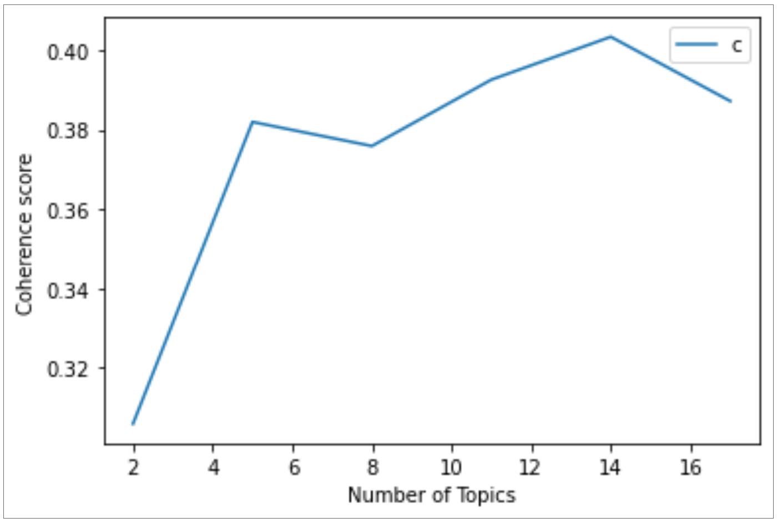
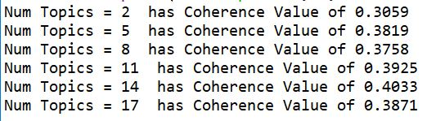
Model Optimisation - Contd.
Number of Topics:
In this step, I have kept the default values for alpha and beta, and calculated the coherence scores for varying number of topics. I have calculated coherence for topics varying from 2 to 20 with step of 3.
Achieved the following coherence graph and scores.
Observing the graph and the values, we can go for 14 number of topics, as the graph rises till coherence value of 0.40 and then steep down.

Slide 25
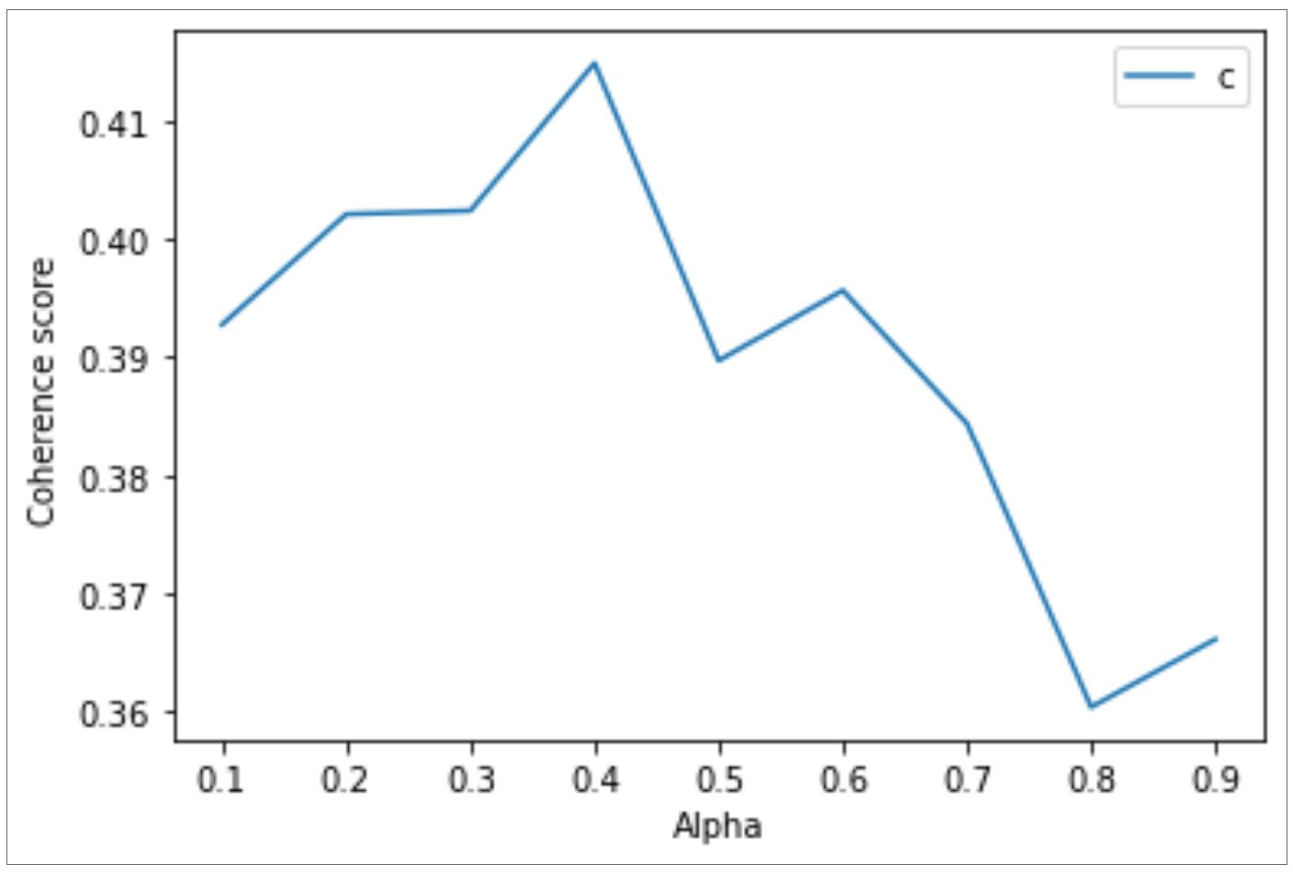
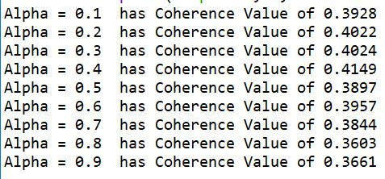
Model Optimisation - Contd.
2. Alpha:
In this step, I have kept default value for beta, number of topics as 14 and have achieved coherence value for varying values of alpha.
Achieved the following coherence graph and scores.
Observing the graph and the values, we can go for alpha value 0.4, as the graph rises till coherence value of 0.41 and then steeps down.

Slide 26
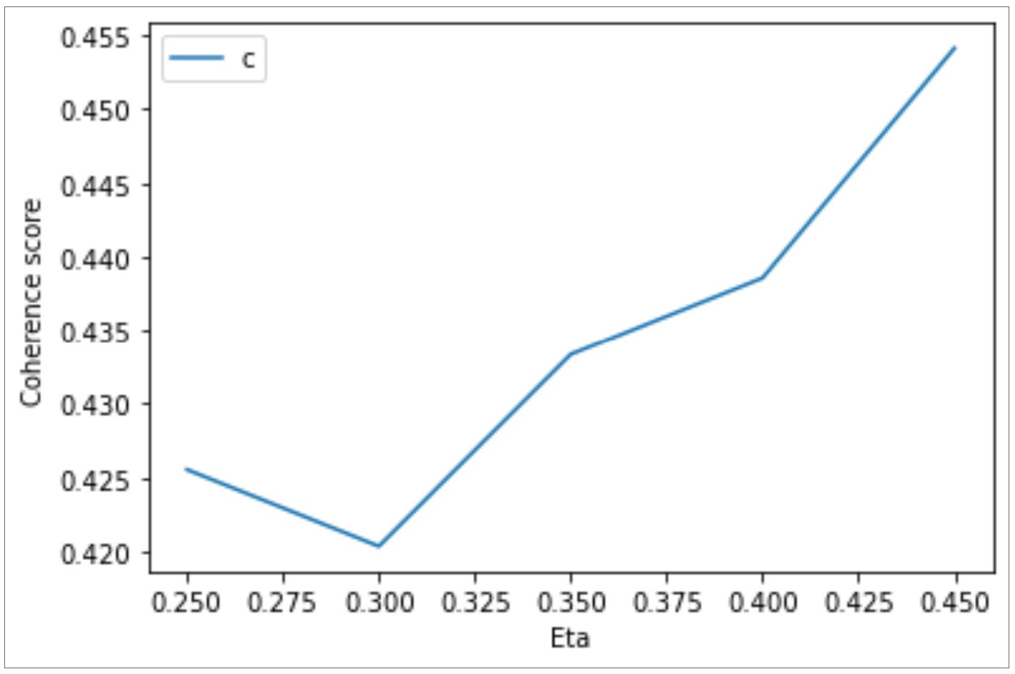
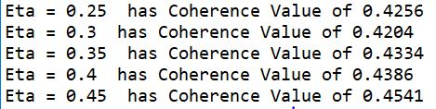
Model Optimisation - Contd.
3. Beta:
In this step, I have taken number of topics as 14, alpha value has 0.4 and have achieved coherence value for varying values of beta.
Achieved the following coherence graph and scores.
Observing the graph and the values, we can go for beta value 0.25, as the graph steeps down from coherence 0.42.

Slide 27
Final Model
Now that we have the optimum values for number of topics, alpha value and beta value, I have built the model using the respective value and following algorithm :
lda_model = gensim.models.LdaMulticore(corpus=corpus,
id2word=id2word,
num_topics=14,
random_state=100,
chunksize=100,
passes=10,
alpha=0.4,
eta = 0.25,
per_word_topics=True)
Coherence score achieved for above model is 0.45668, which is better than 0.42463 ( achieved from the base model).

Slide 28
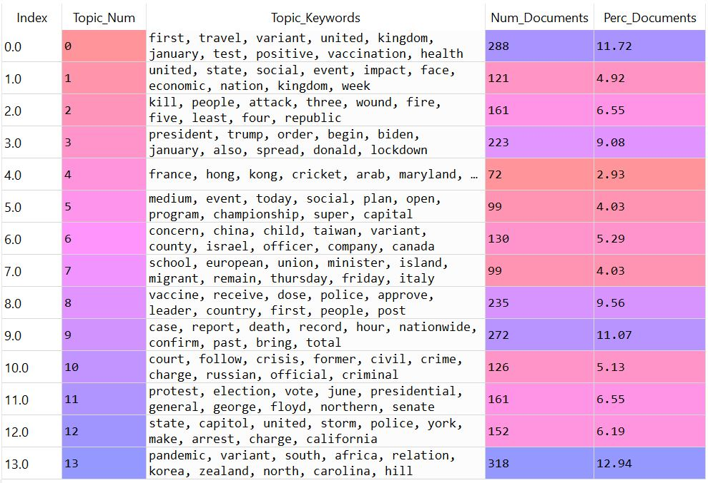
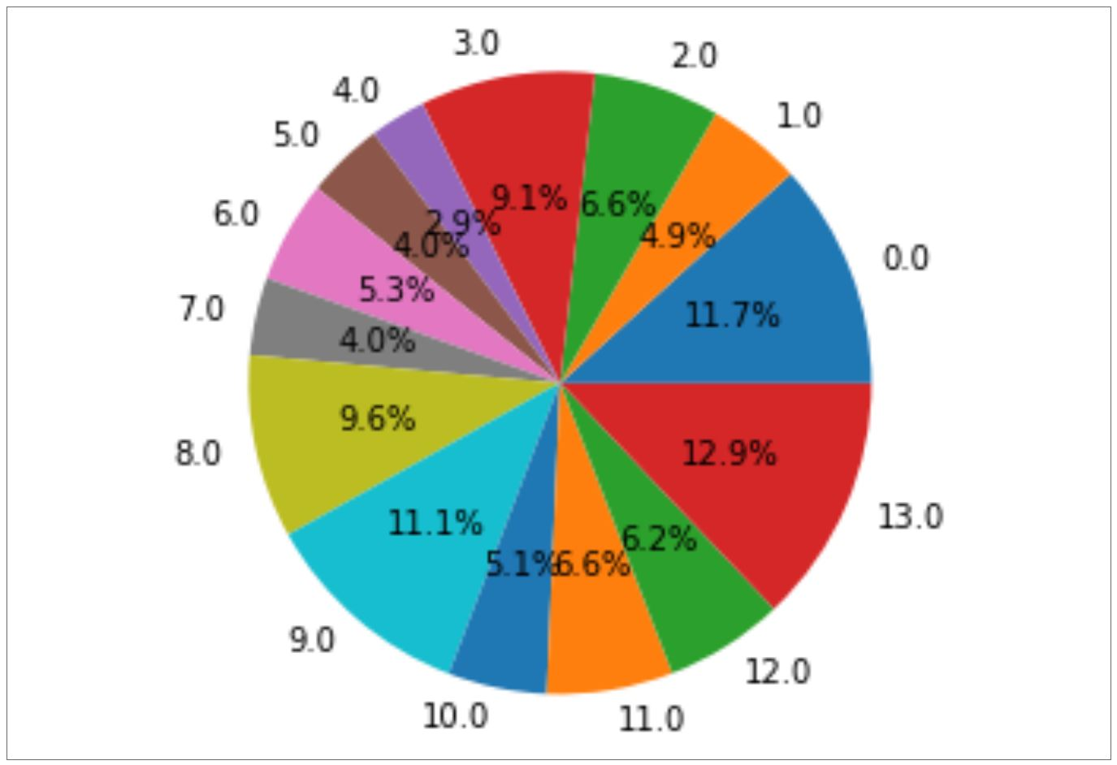
Output Visualisation
In the following table we can see the 14 topics achieved from the optimised model along with the number of documents & the percentage of documents contributing to the respective topics.
A pie chart also gives a good visualisation about the topics contribution.
Thus, helping the client and satisfying the business objective in choosing the right topics.

Slide 29
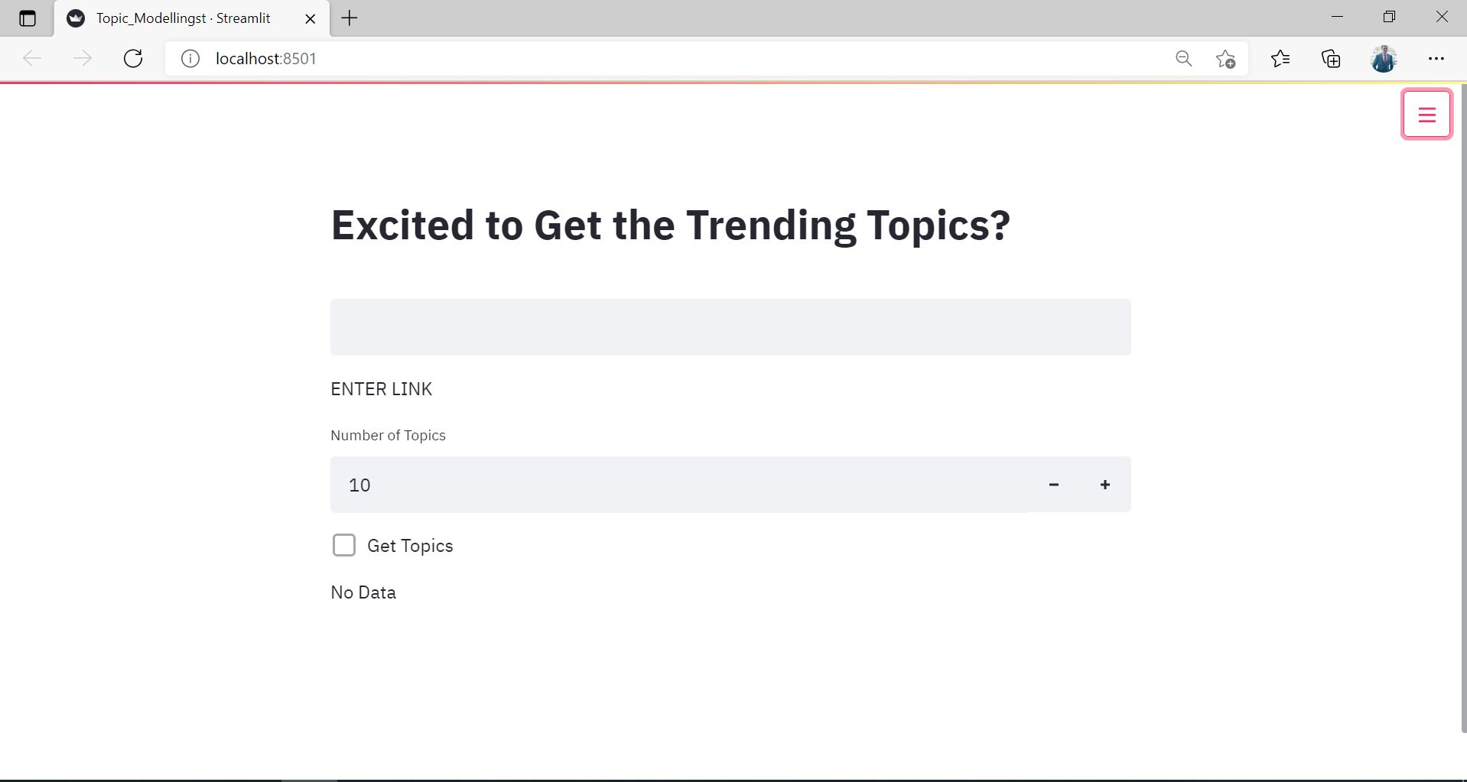
Deployment - Streamlit

Slide 30
Thank You

